Slide 1


Title: Customer churn analytics for the banking industry
Subtitle: A data-driven exploration into churn behavior
Name:- Soham Patil
Branch:- MBA(BA) 2nd Sem.
Date:- 30-06-2025

Slide 2
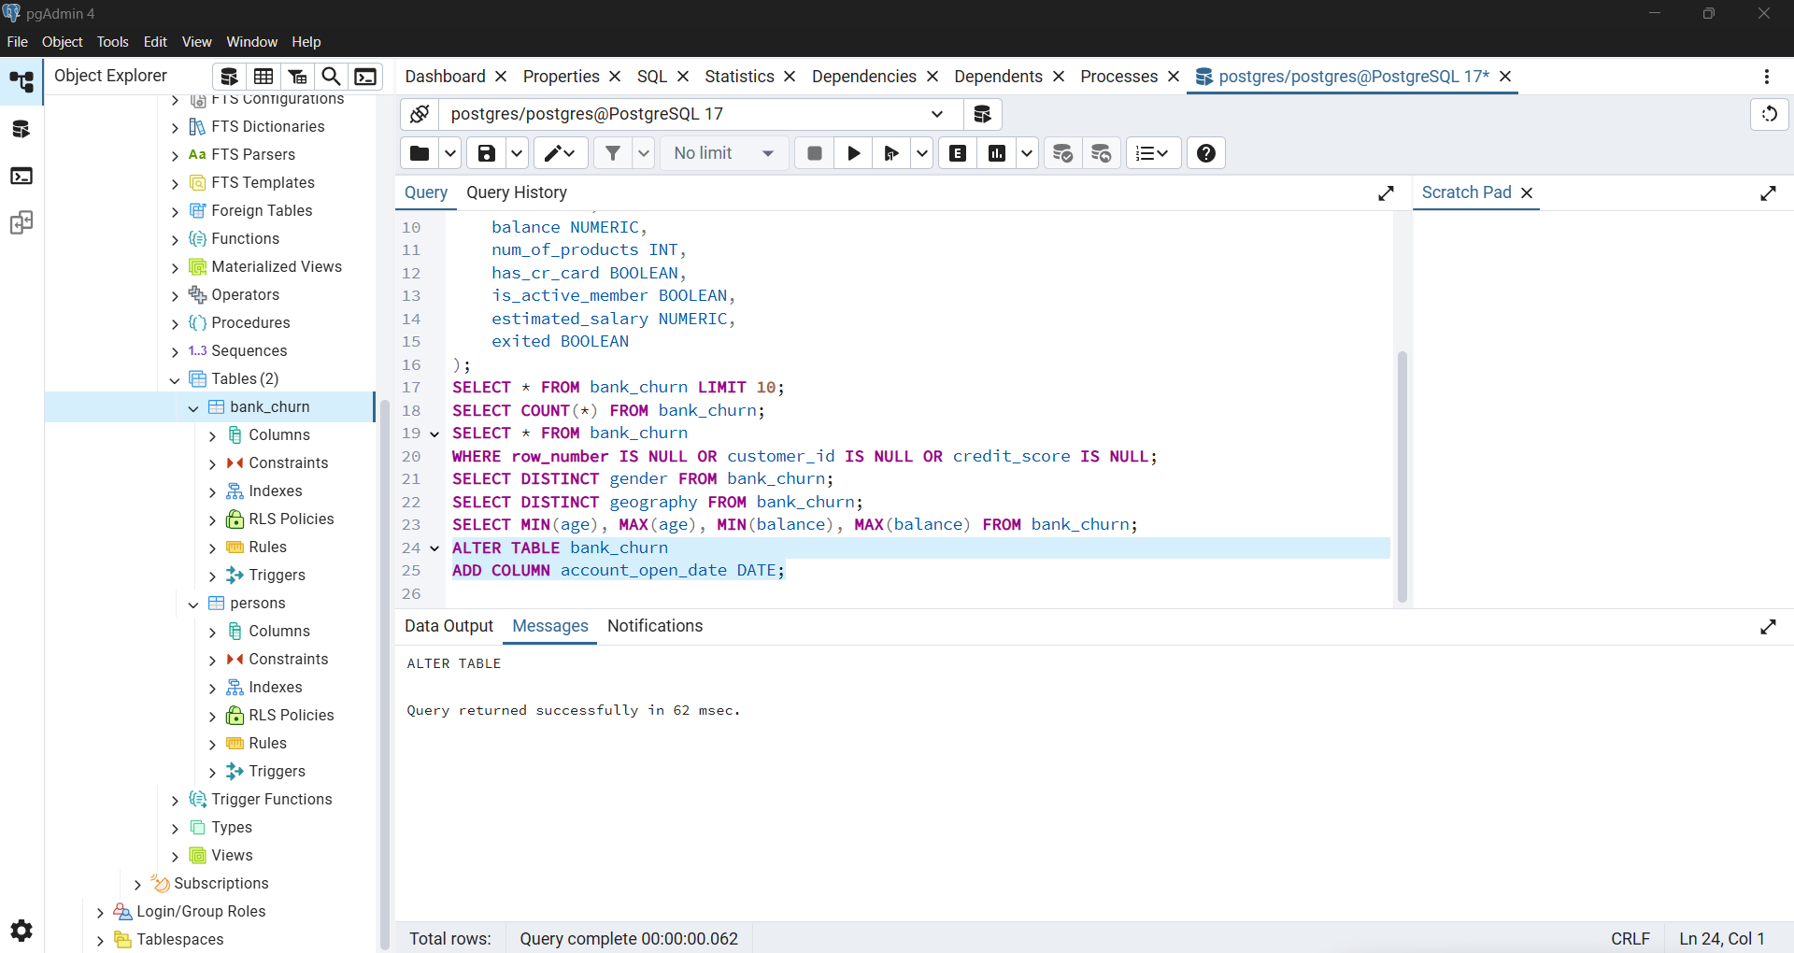
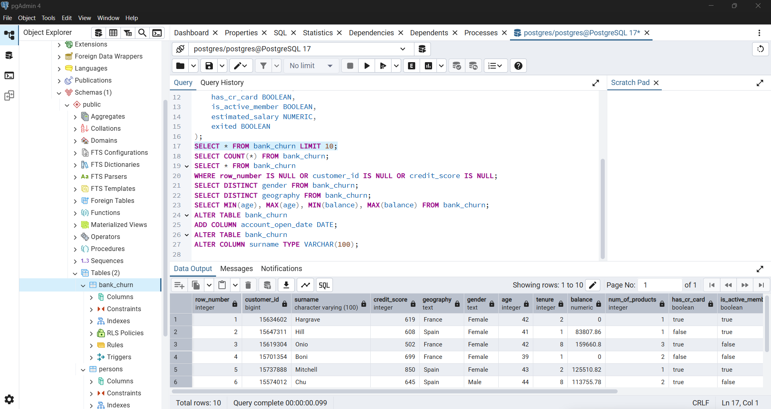
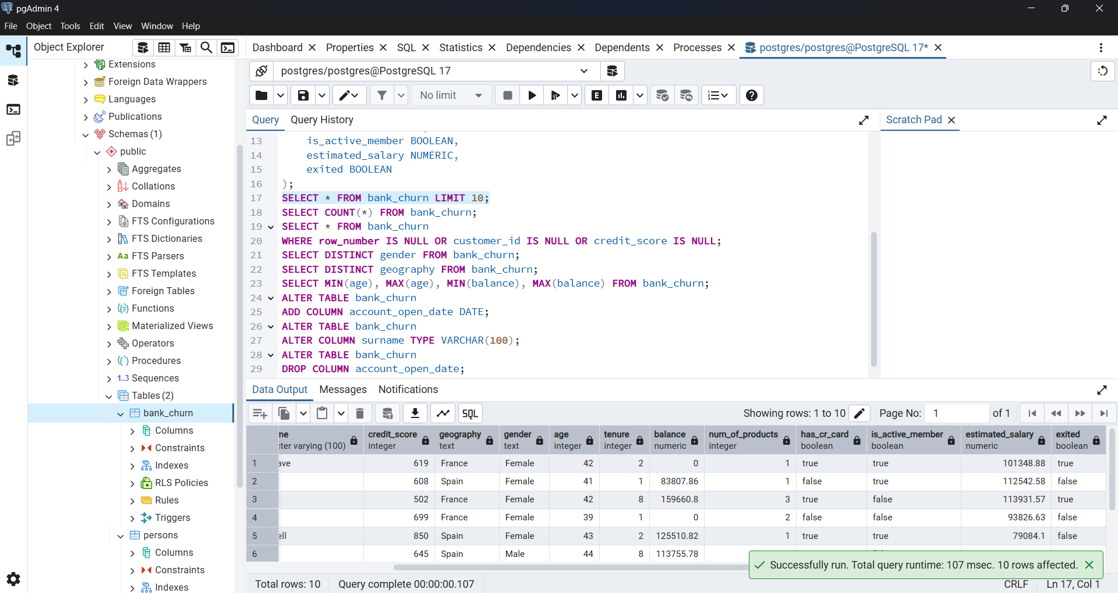
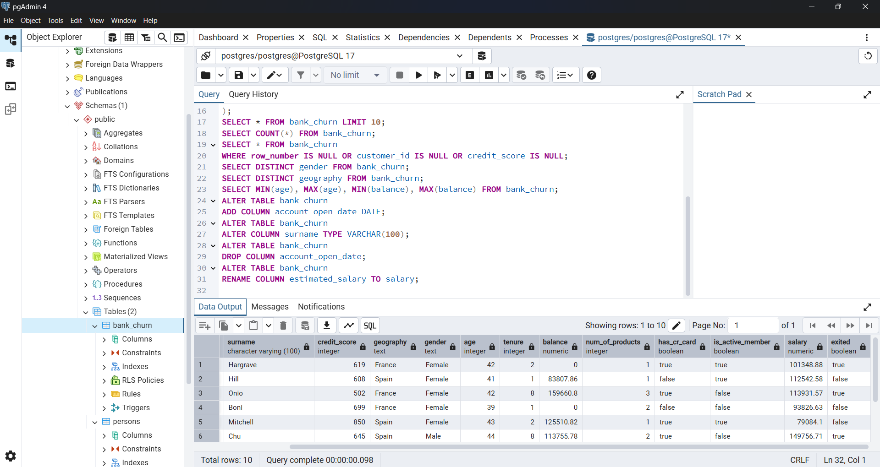
DDL or Data Definition Commands

Slide 3
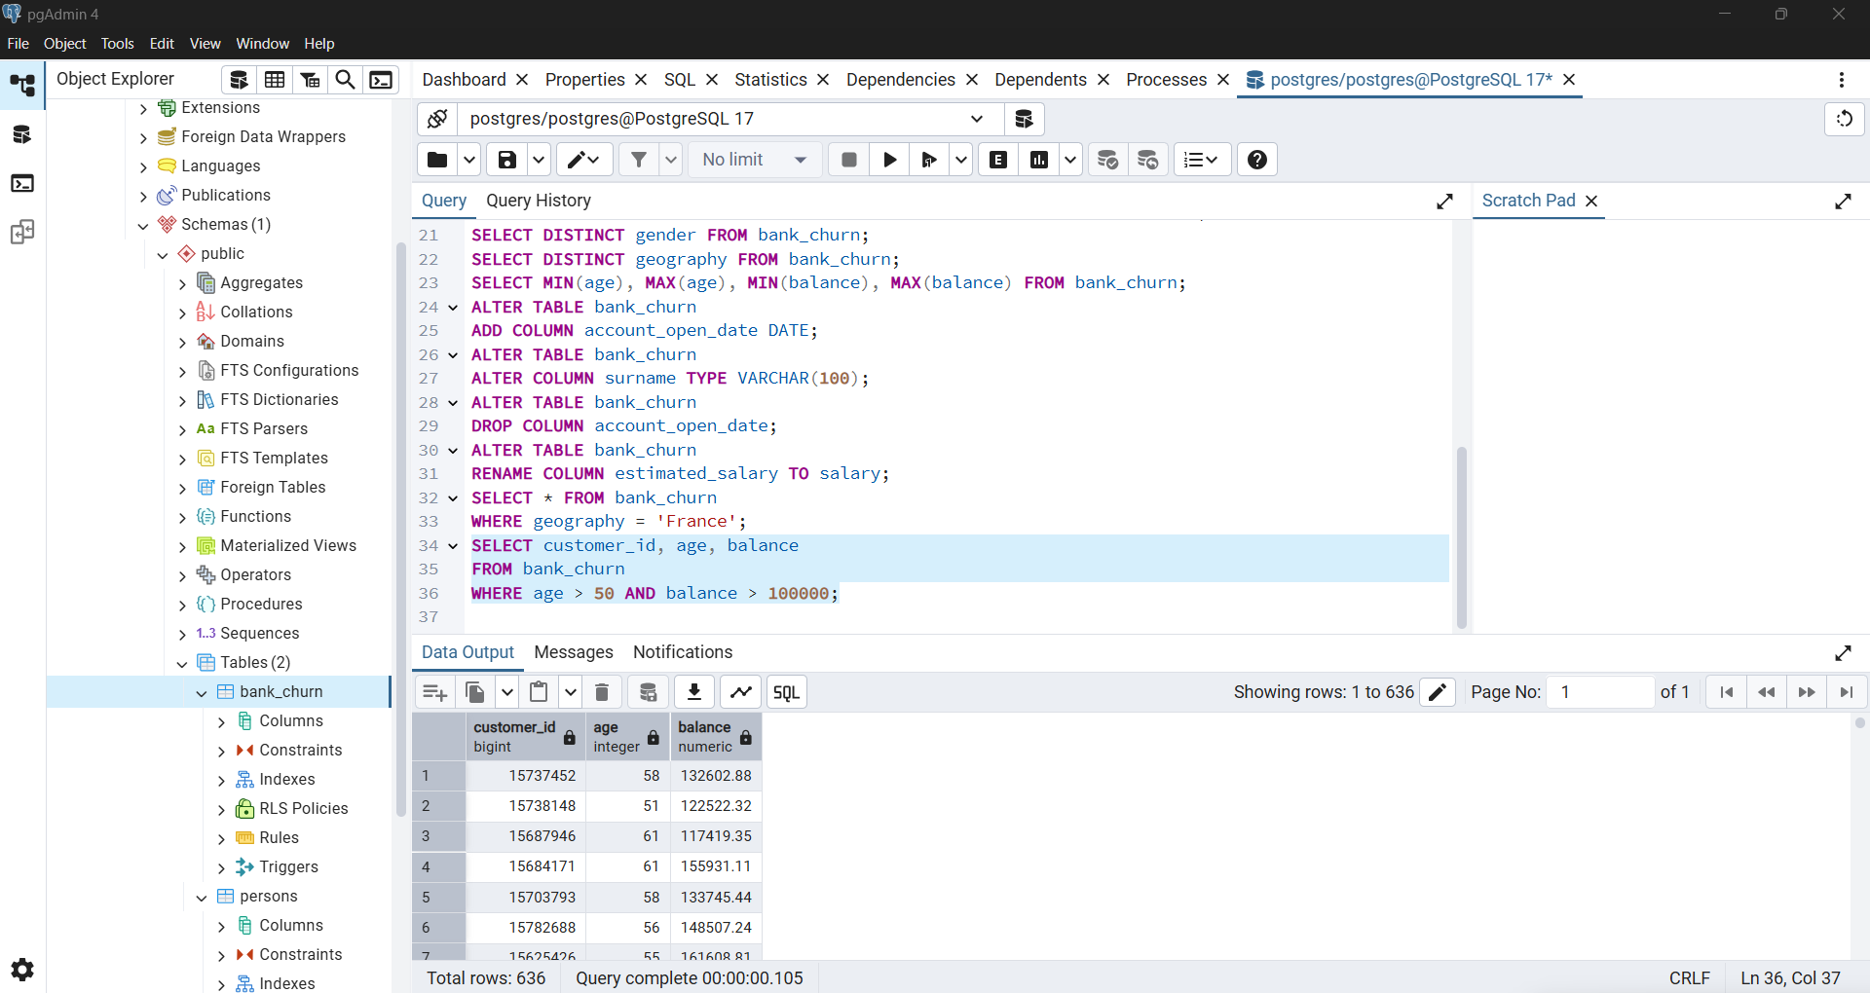
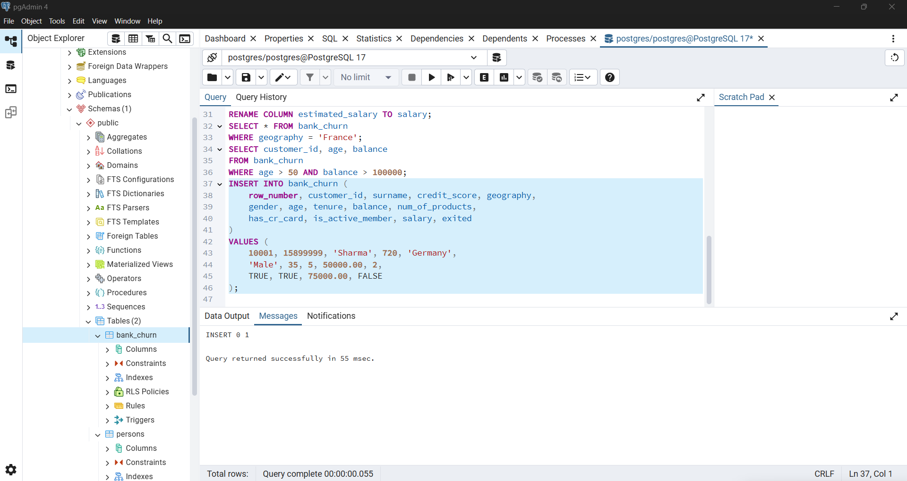
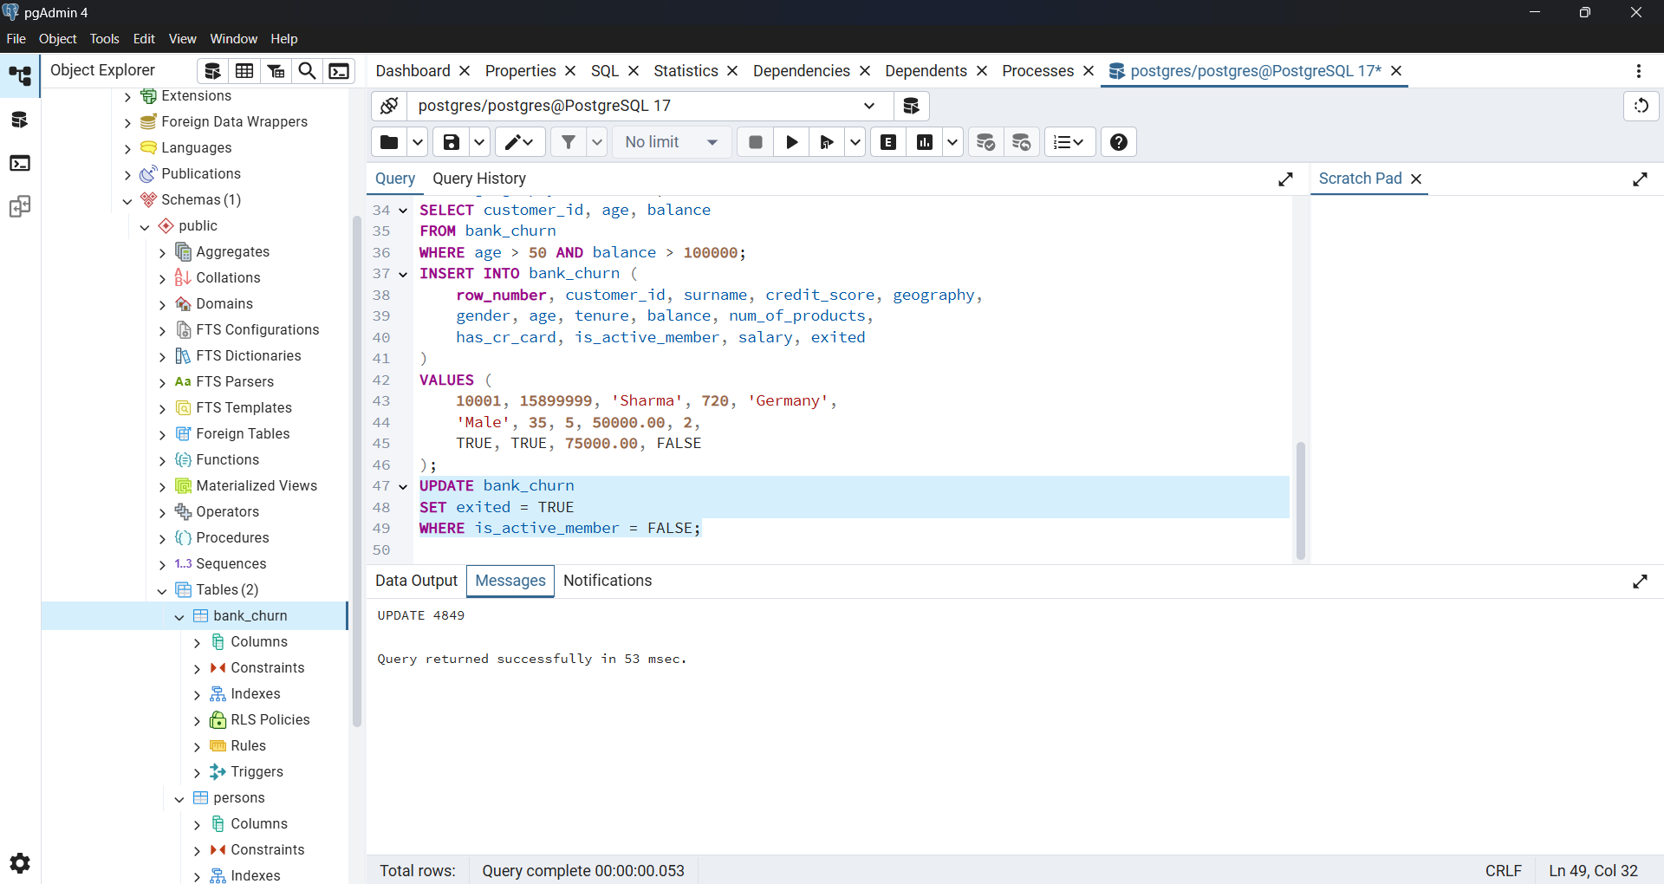
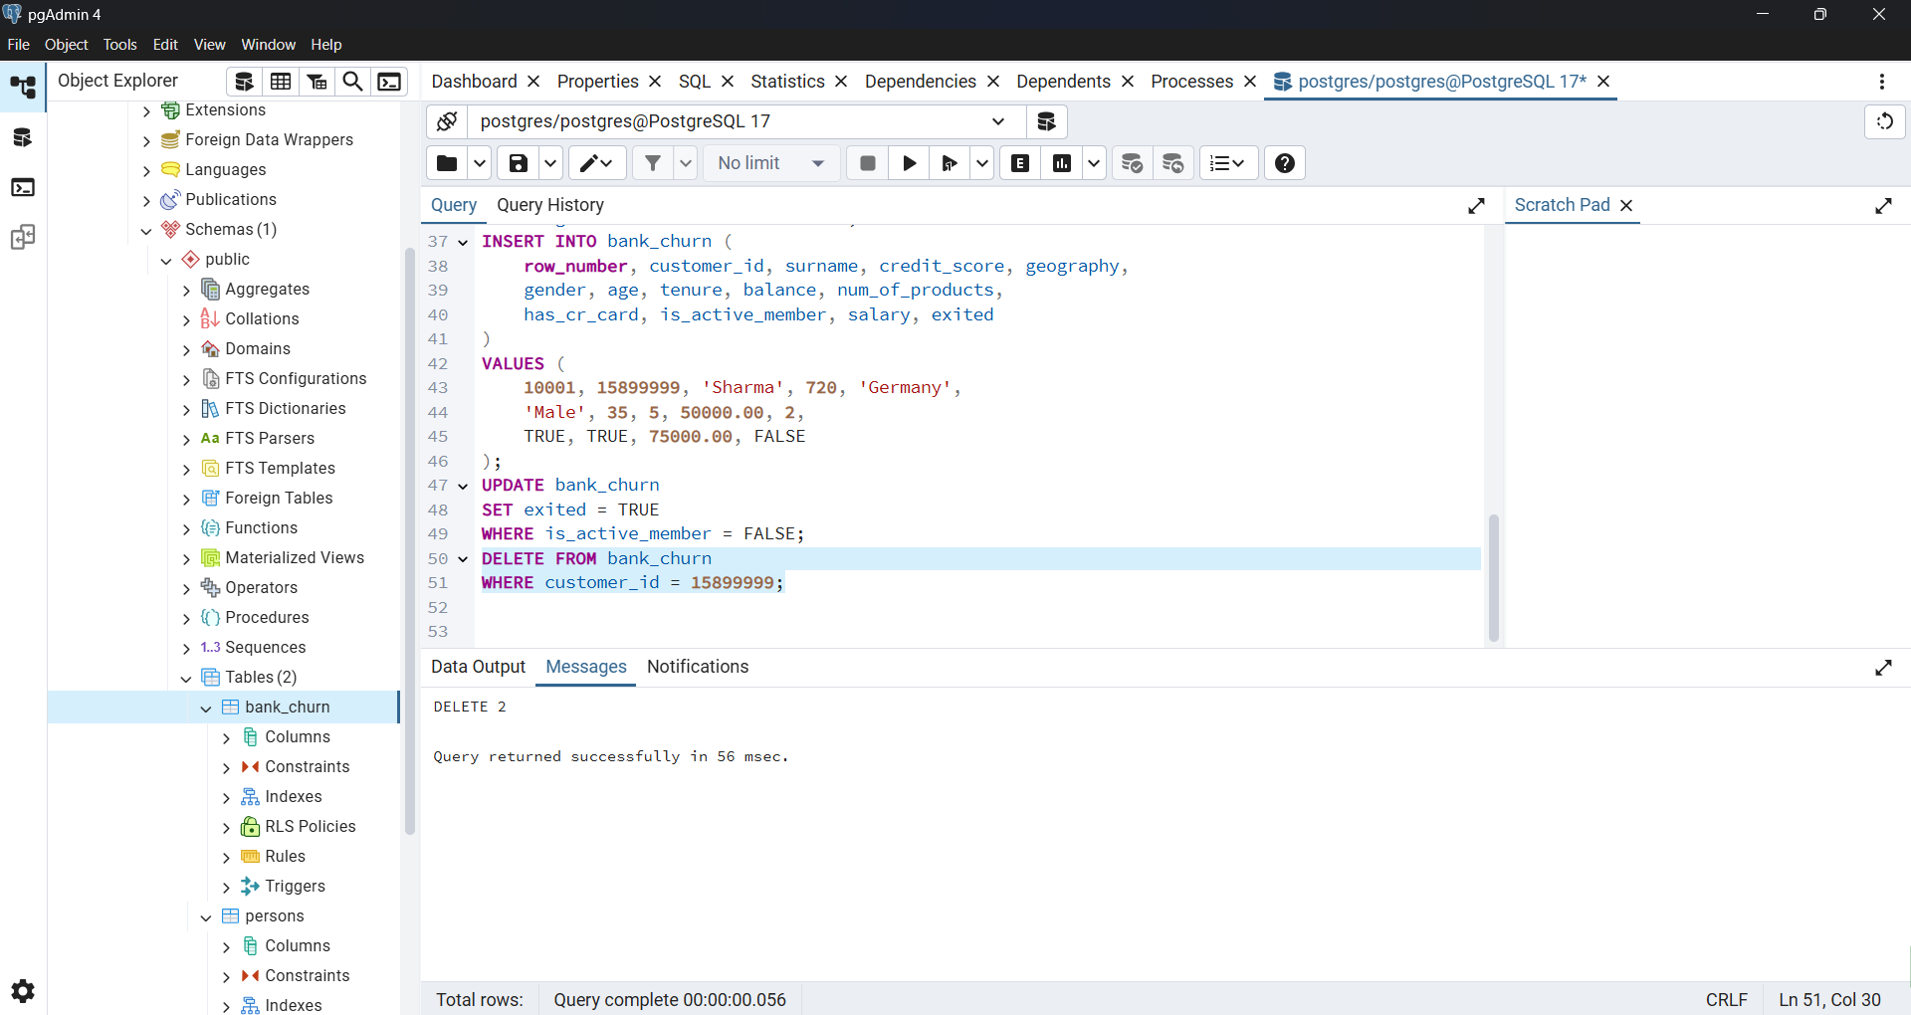
DML or Data Manipulation Language

Slide 4
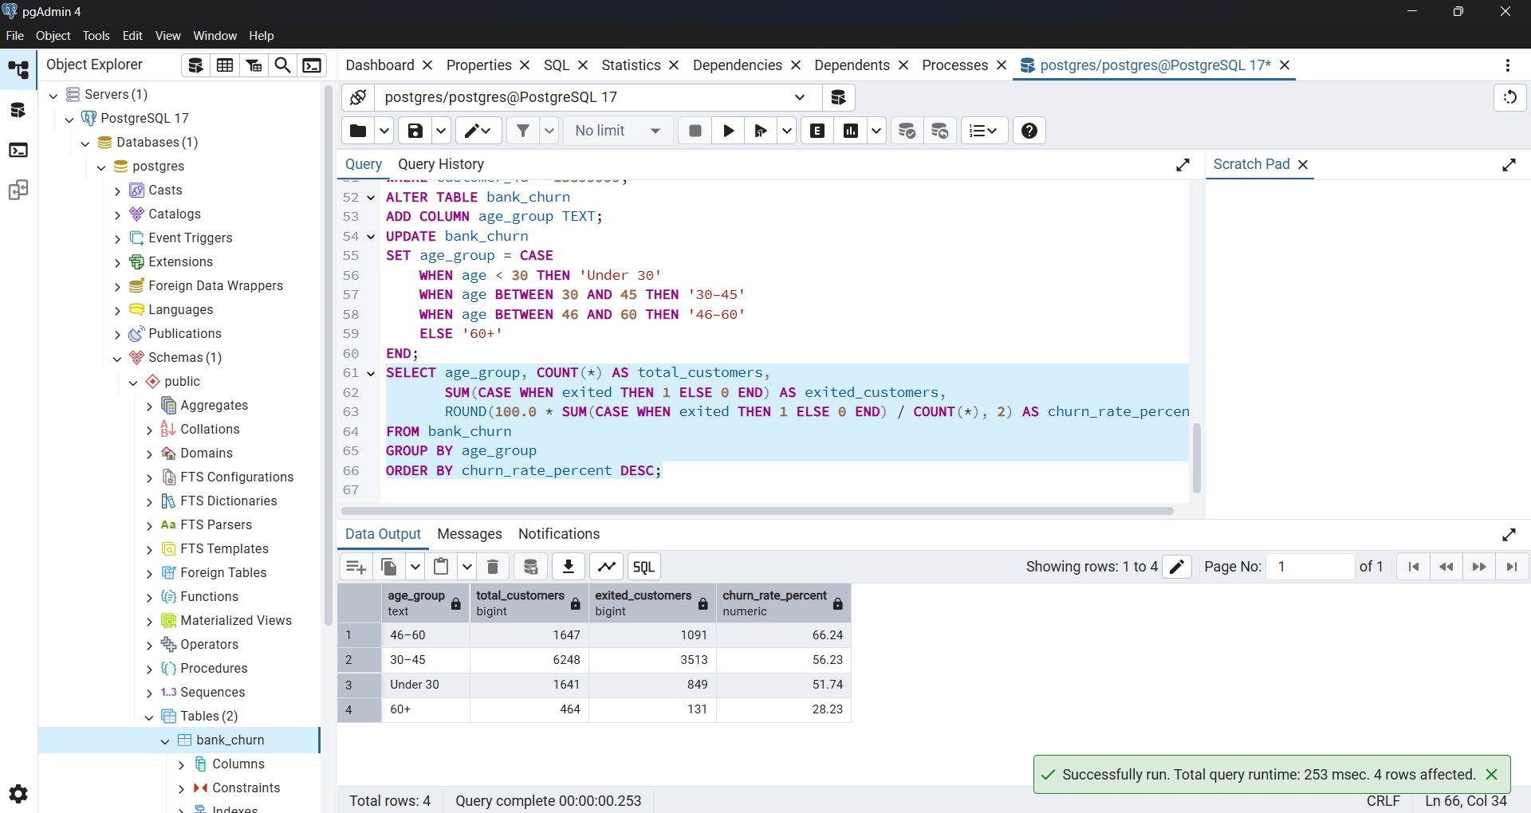
Explore Churn by Age Group

Slide 5
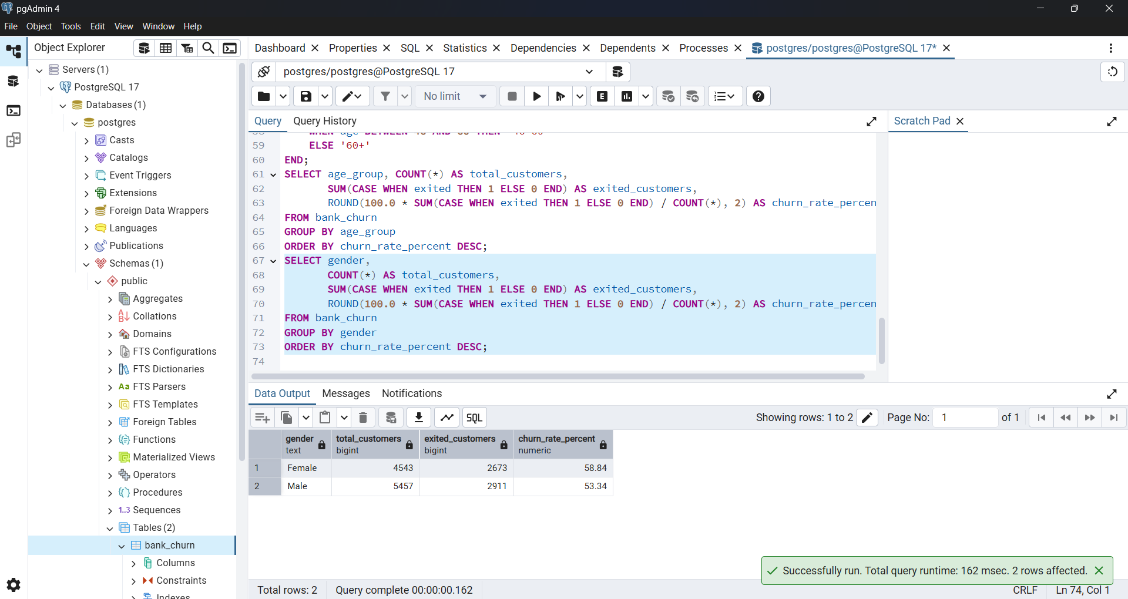
Gender-wise Churn

Slide 6
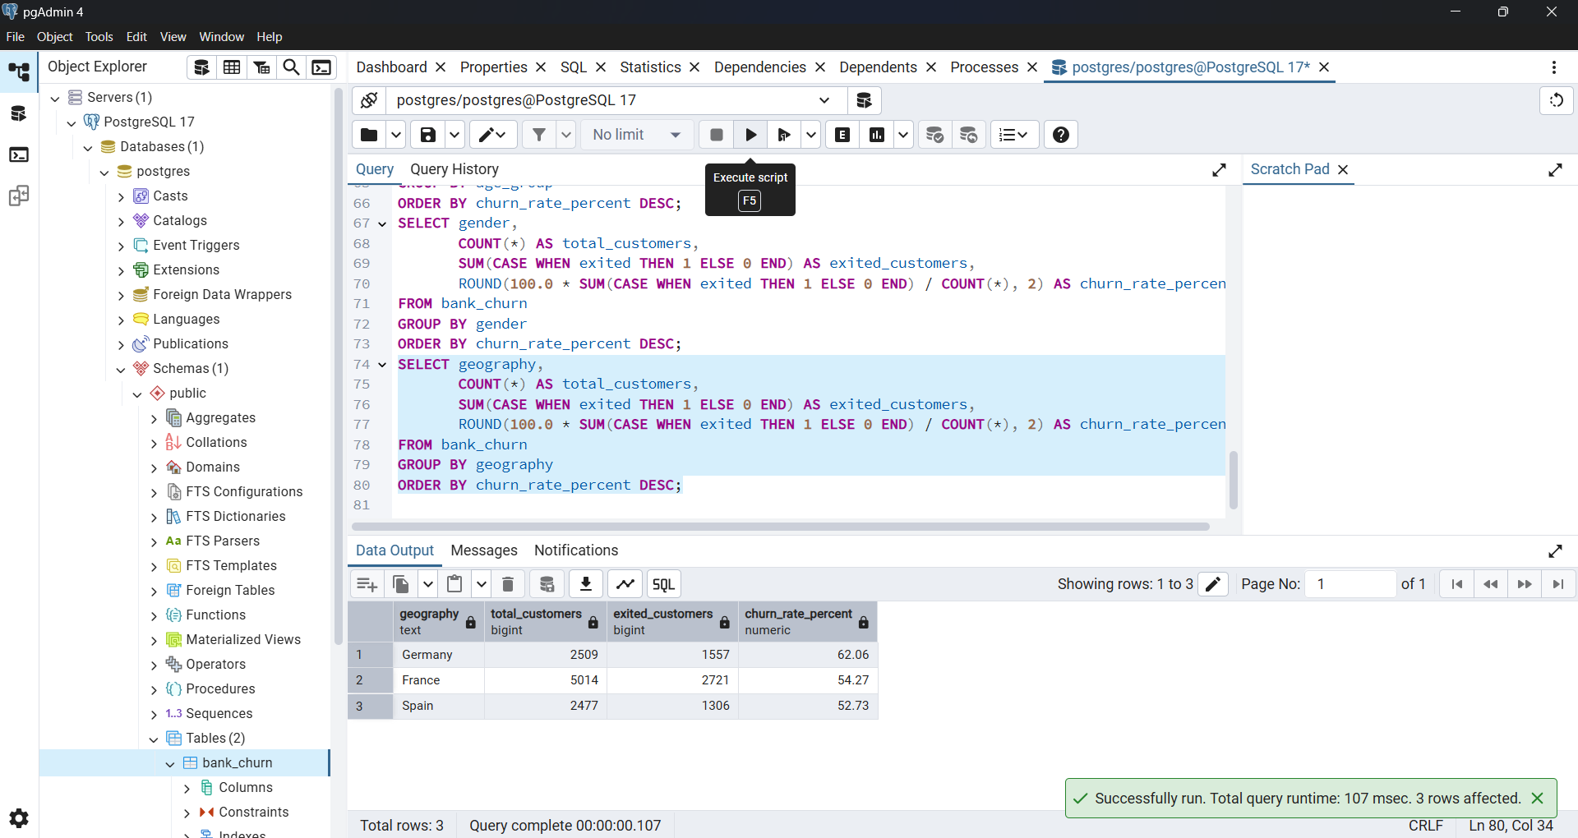
Geography-wise Churn

Slide 7
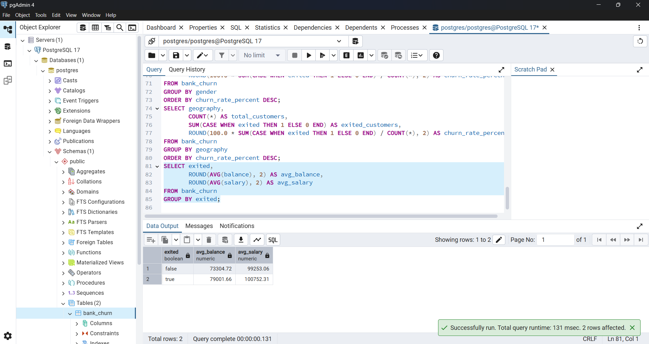
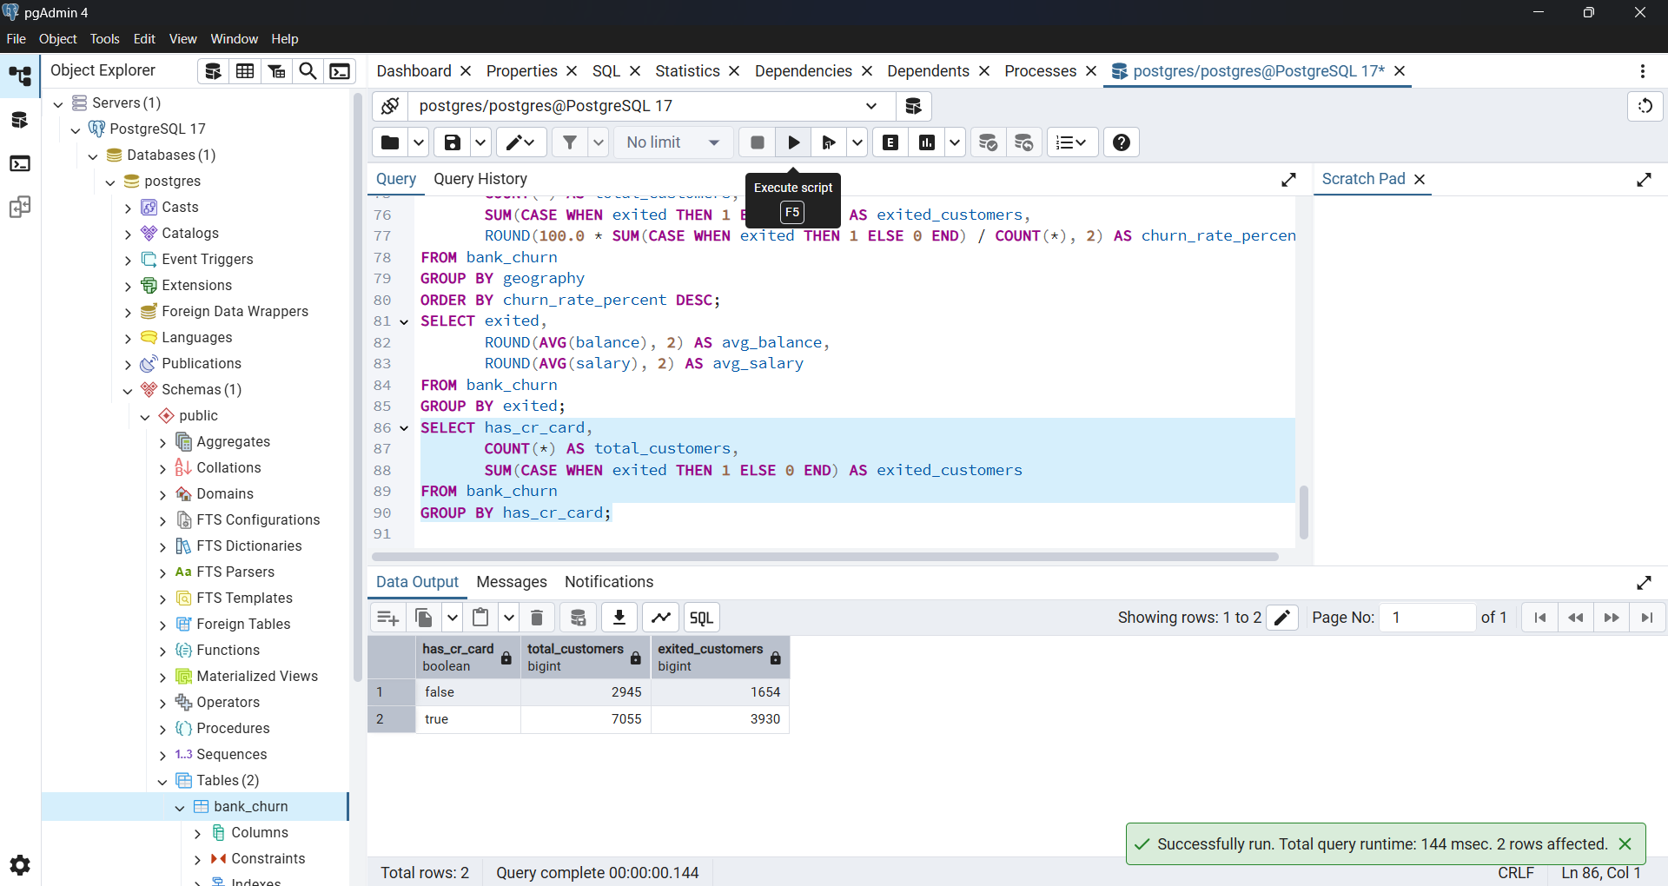
Financial Behavior
Average balance and salary by churn status
Credit Card ownership vs churn

Slide 8
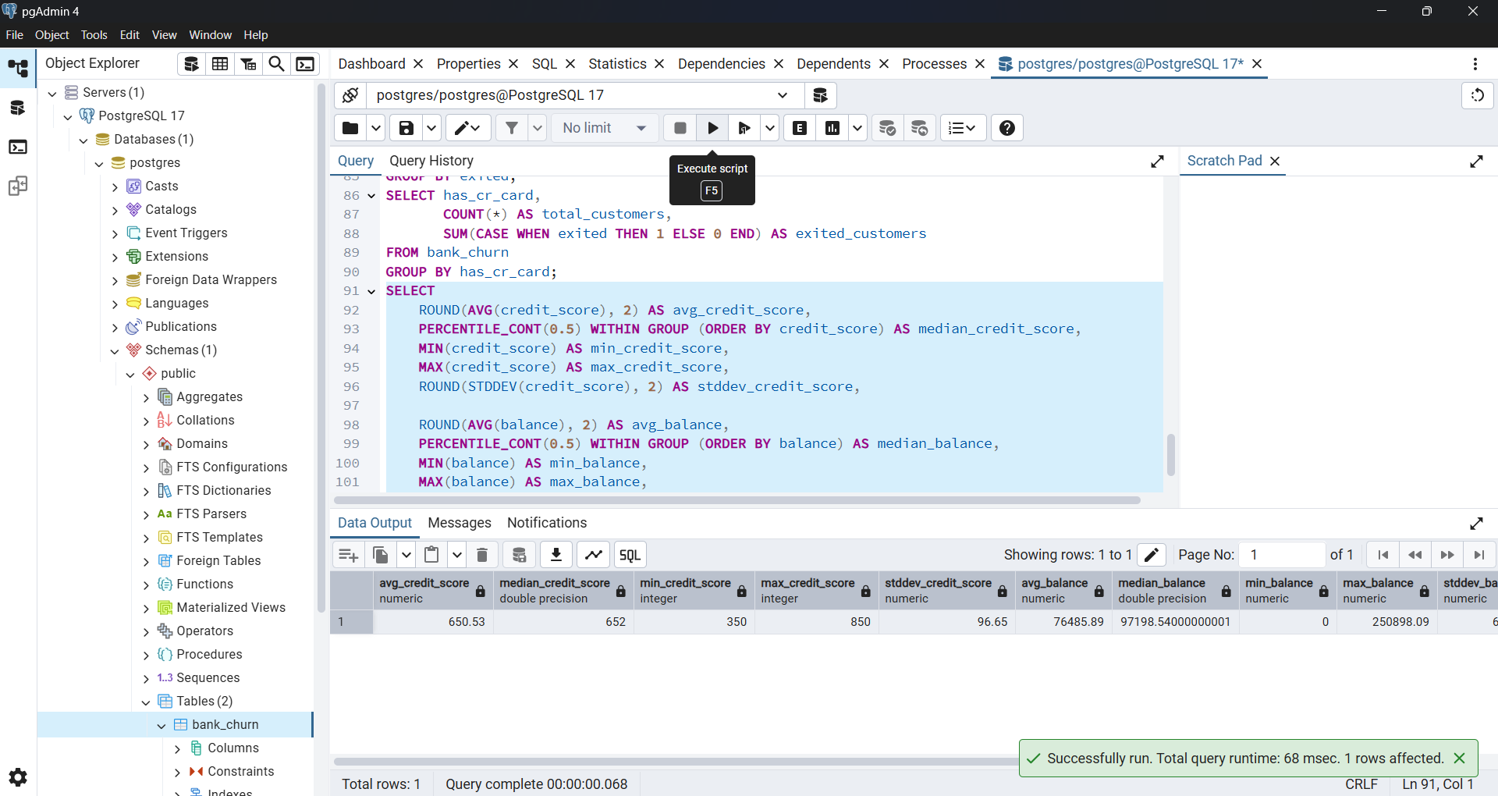
Summary Stats Query (Credit Score & Balance)

Slide 9
customer churn analytics for the banking industry
Metric | Reason for Inclusion
Customer Activity Status | Strong direct indicator of customer engagement
Age | Captures life-stage patterns influencing churn
Balance | Identifies financial importance of churned customers
Number of Products | Reveals cross-sell effectiveness and customer stickiness
Geography | Detects regional churn patterns
Credit Score | Flags risk-prone customer segments
Gender | May offer behavioral segmentation, even if not dominant

Slide 10
Summary: Customer Churn Analytics Report
This report offers a data-driven analysis of customer churn within a banking dataset. Using SQL-based segmentation and statistical exploration, the report identifies key churn drivers such as:
Age: Customers aged 46–60 show notably higher churn.
Gender & Geography: Churn patterns vary by region and demographic.
Financial Behavior: High churn among low-product users and inactive members.
Balance & Salary: Churned customers often exhibit distinct financial profiles.
Key tools like DDL and DML commands were applied to build, query, and analyze the dataset. The report concludes with a statistical summary (mean, median, and standard deviation) for metrics like credit score and balance, reinforcing the presence of outliers and skewed data distributions.

